Slide 1
Machine Learning and Artificial Intelligence for every developer with ML.NET and Visual Studio 2019
Pranav Rastogi
@rustd

Slide 2









Your platform for building anything
DESKTOP
WEB
CLOUD
MOBILE
GAMING
IoT
ML
.NET
Notes:
.NET is a great tech stack for building a wide variety of applications. There is ASP.NET for web development, Xamarin for mobile development and with ML.NET we are trying to make .NET great for Machine Learning.

Slide 3




ML.NET is a machine learning framework made for .NET developers
Build your own
Proven & Extensible
Open Source & Cross platform
Developer Focused
ML.NET is available @
dot.net/ml
Notes:
So just to summarize, ML.NET is a machine learning framework made specifically targeted for .NET developers.
With ML.NET you can build custom ML models, ML.NET is used very heaving within Microsoft and starting to be adopted externally as well.

Slide 4









Machine Learning scenarios with ML.NET
Sentiment Analysis
Forecasting
Issue Classification
Predictive maintenance
Ranking news/topics
Recommendations
Image classification
Customer segmentation
And many more examples
@ https://github.com/dotnet/machinelearning-samples

Slide 5






ML.NET is proven at scale, enterprise ready (aka. TLC: MSFT internal for years)
Bing Ads (Ad Predictions)
Excel (Chart Recommendations)
Power Point (Design Ideas)
Windows 10 (Windows Defender)
Azure Stream Analytics (Anomaly Detection)
Power BI (Key Influencers)
+ more
Notes:
Even though we just recently released ML.NET at Build this year, ML.NET has been used at Microsoft heavily for over a decade by iconic MS products.
Bing Ads uses ML.NET for add-click predictions
Excel uses ML.NET for chart recommendations
PowerPoint uses ML.NET for Design Ideas
Windows10 uses ML.NET for Windows Defender

Slide 6
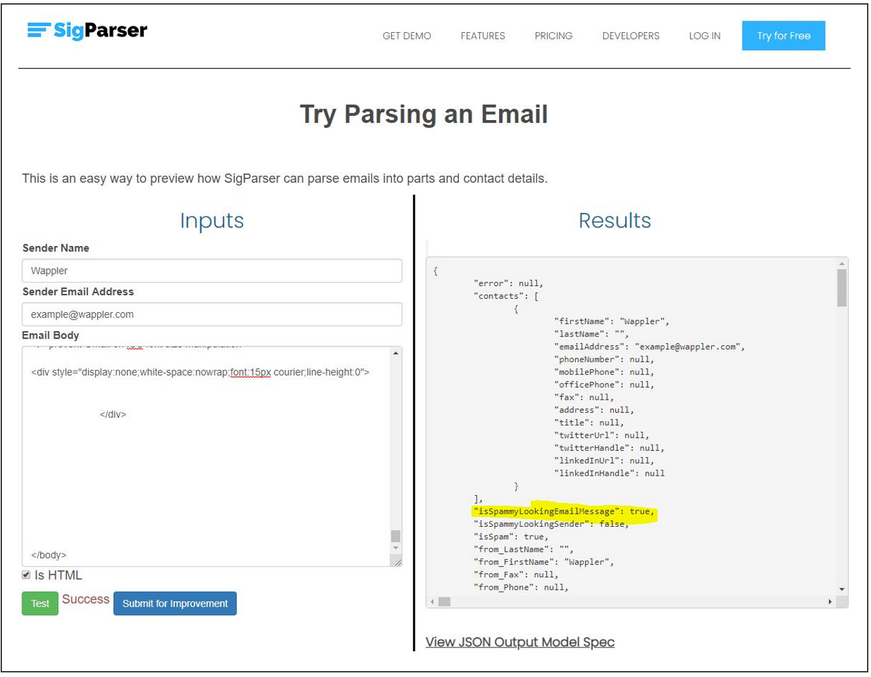
SigParser uses ML.NET
"With ML.NET, we're able to train the model and then immediately test it inside of our code. This makes shipping new changes faster because all the tooling was together in one place.“
Paul Mendoza, CEO and founder SigParser https://sigparser.com/
https://dotnet.microsoft.com/apps/machinelearning-ai/ml-dotnet/customers

Slide 7
Sentiment Analysis

Slide 8
Sentiment Analysis
Comment | Toxic? (Sentiment)
==RUDE== Dude, you are rude … | 1
== OK! == IM GOING TO VANDALIZE … | 1
I also found use of the word "humanists” confusing … | 0
Oooooh thank you Mr. DietLime … | 0
Features (input)
Label (output)
Wikipedia detox data at https://figshare.com/articles/Wikipedia_Talk_Labels_Personal_Attacks/4054689

Slide 9

Sentiment Analysis explained
Is this A or B?
Is this a toxic comment?
Yes or no

Slide 10
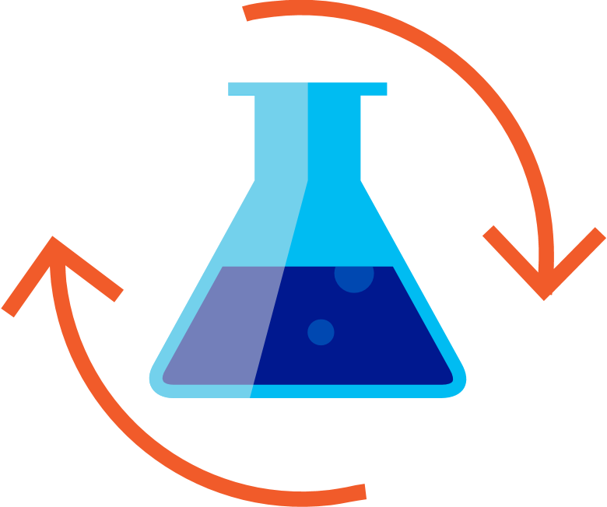

Machine Leaning workflow
Prepare Your Data
Build & Train
Run
Load Data
Extract Features
Train Model
Evaluate Model
Model Consumption

Slide 11
Image Classification

Slide 12


Deep Learning
Revolutionizing areas like computer vision and speech recognition
Takes advantage of large amounts of data and compute
Image (input)
Dog
Not a dog
Dog
Not a dog

Slide 13
Try ML.NET today!
Get started at
http://dot.net/ml
Try the samples at
http://aka.ms/mlnetsamples
Read the docs at
http://aka.ms/mlnetdocs
Request features or contribute at
http://aka.ms/mlnet
Get help for going into production
https://aka.ms/mlnetprod

Slide 14
Thank you!

